Slide 1
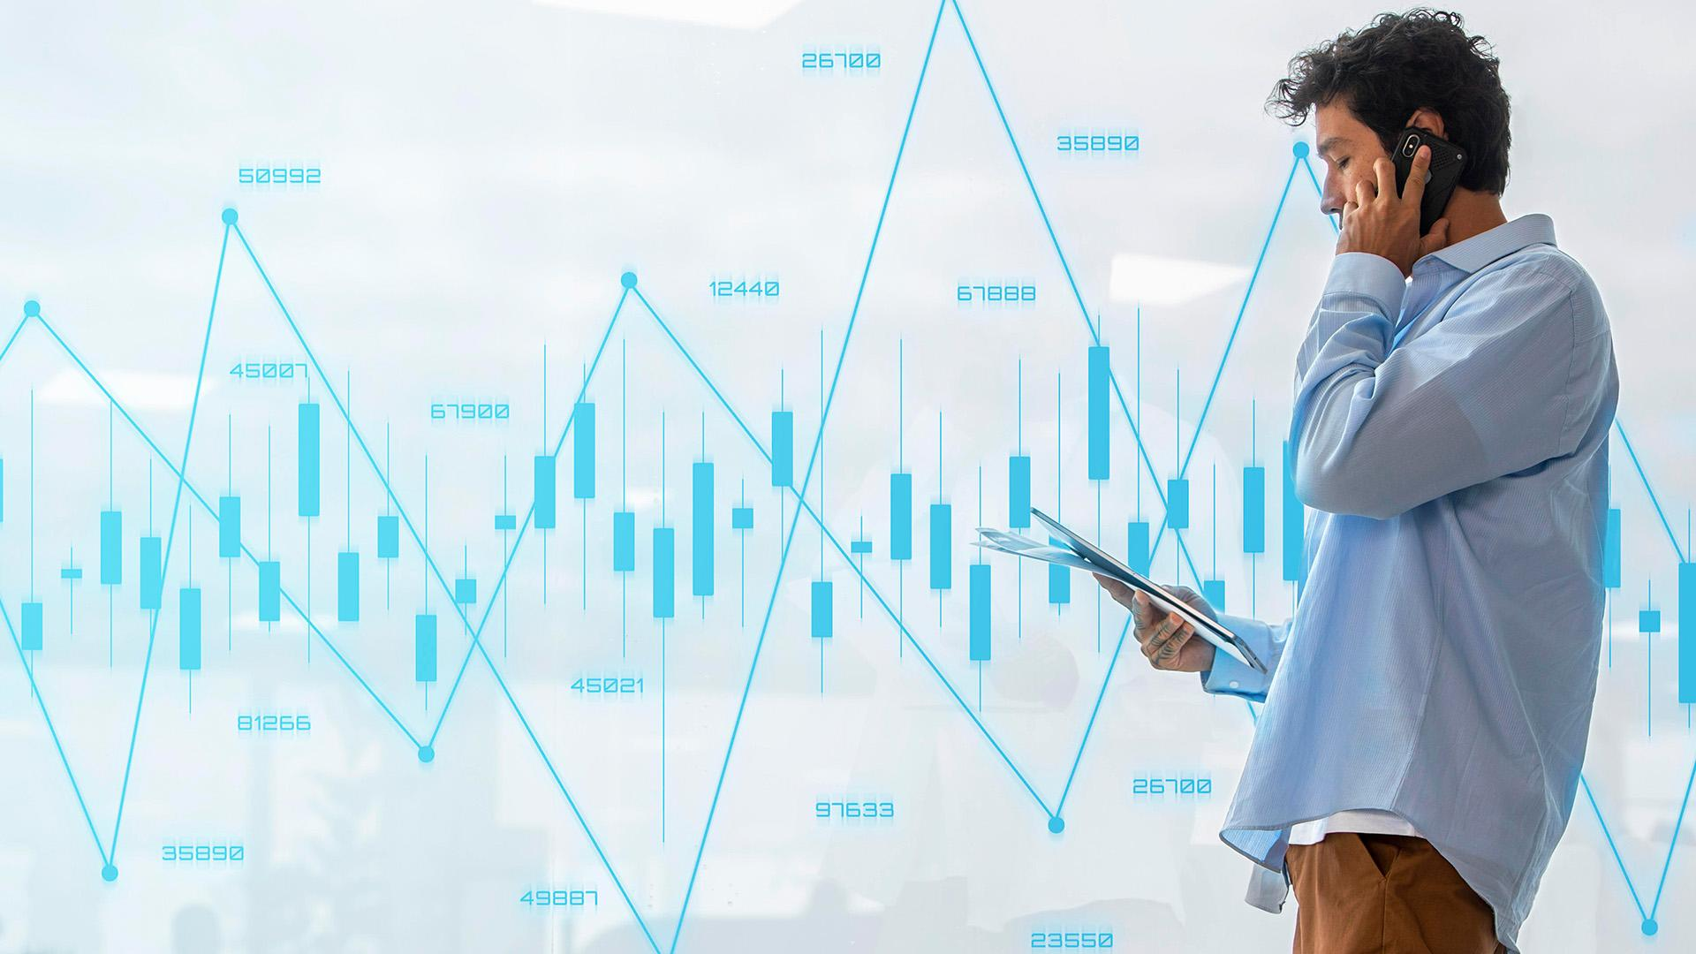
Overview of Major Tech Companies in the U.S. Market:
Financial Performance and Stock Price Prediction
Group 3

Slide 2
Table of contents
01
02
03
04
05
06
07
Project Objective
Dataset Description & EDA
Methodology
Analysis and Discussion
Challenges and Limitations
Future Work
Conclusion

Slide 3

01
Project Objective

Slide 4

Project Objective
Provide a comprehensive overview of the financial performance of the top 5 major technology companies in the U.S. market:
Data Visualization of Financial Performance
Machine Learning for Stock Price Prediction
Equip investors and stakeholders with actionable insights to inform their decision-making processes.

Slide 5
02
Dataset Description & EDA

Slide 6





Introduction to the dataset
Data Collection: Utilized Yahoo Finance to gather historical stock price data for the following five tech companies:
- Apple (AAPL)
- Microsoft (MSFT)
- Alphabet (GOOGL)
- Meta Platforms (META)
- Tesla (TSLA)
- Data Range: 1 Jan 2015 to 31 Dec 2024

Slide 7
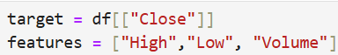
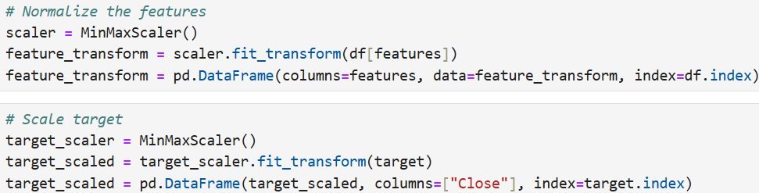
Data preprocessing steps
Data Cleaning: Missing values were handled appropriately, ensuring that all entries were valid.
Target and Feature Selection: The "Close" price was selected as the target variable for predictions, “High”, “Low”, and “Volume” were selected as features
Normalization: The data was scaled to a range of 0 to 1 using MinMaxScaler to improve model training efficiency

Slide 8
Exploratory Data Analysis

Slide 9
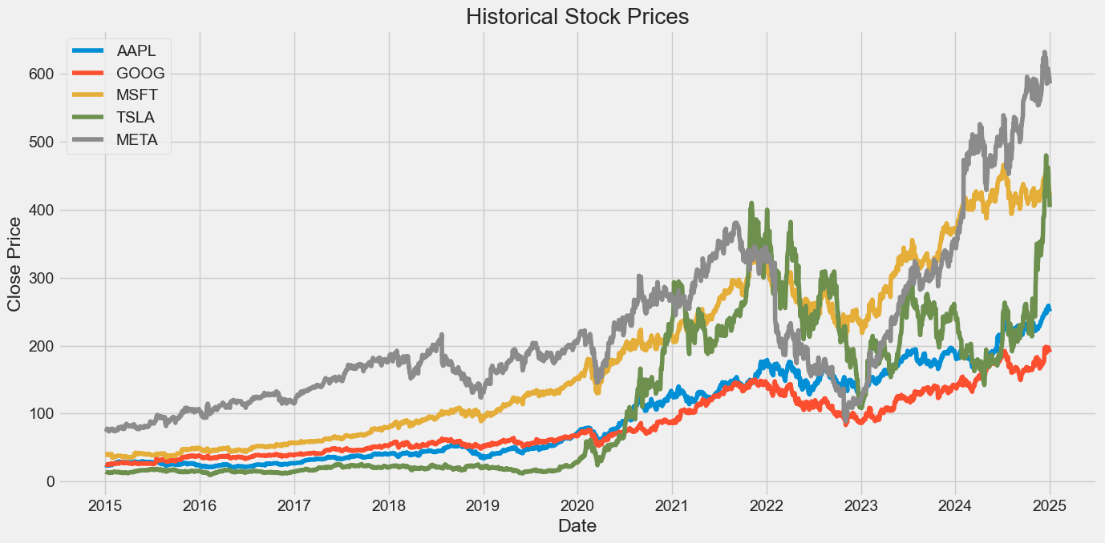
Historical Stock Prices
The historical stock price chart for the 5 stocks: Apple, Google, Microsoft, Tesla, and Meta over the period 2015-2024. The y-axis represents the closing price, and the x-axis represents the date.

Slide 10
Historical Stock Prices
3 Key Insights
1. Overall Growth Trends
General upward trend over the 10-year period
TSLA 2020 onwards, rapid rise in the electric vehicle market.
AAPL, GOOG, and MSFT show steady growth
AAPL potentially outperforming the others in recent years.
META (formerly Facebook) shows growth but may have experienced more volatility
2. Volatility and Market Reactions
2020 COVID-19 Crash
A sharp decline in early 2020, followed by a strong recovery
A potential downturn in 2022
Investors need to be aware of market cycles and external events
3. Relative Performance
TSLA stands out as the top performer
AAPL and MSFT show consistent growth
GOOGLE and META show growth but may lag behind AAPL and MSFT

Slide 11
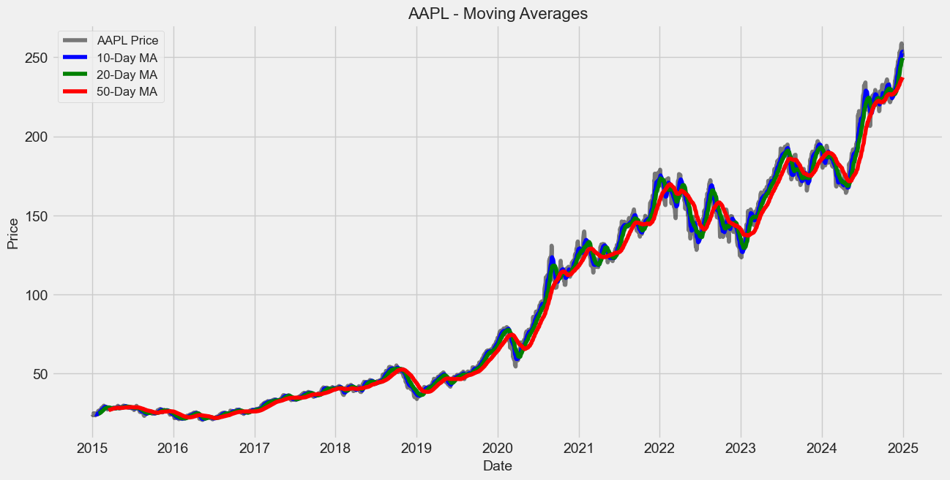
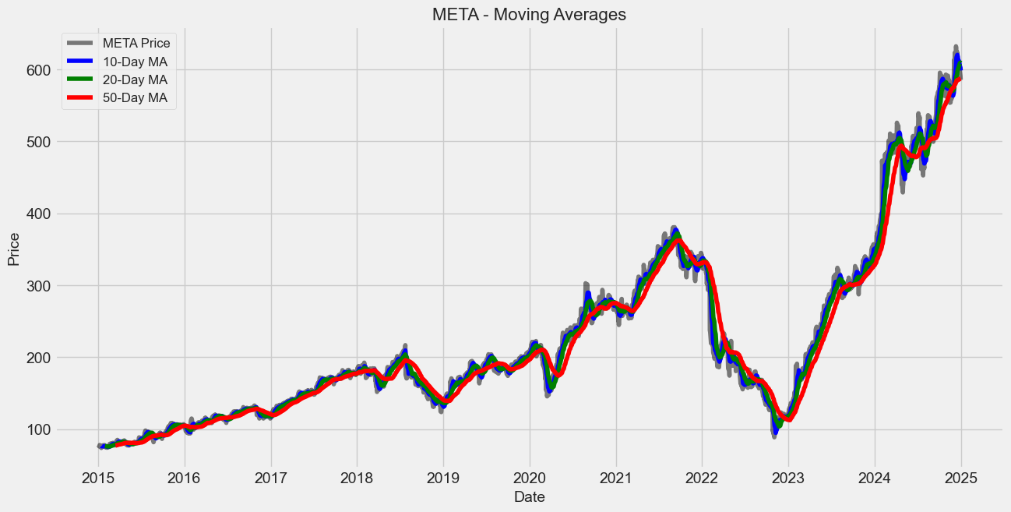
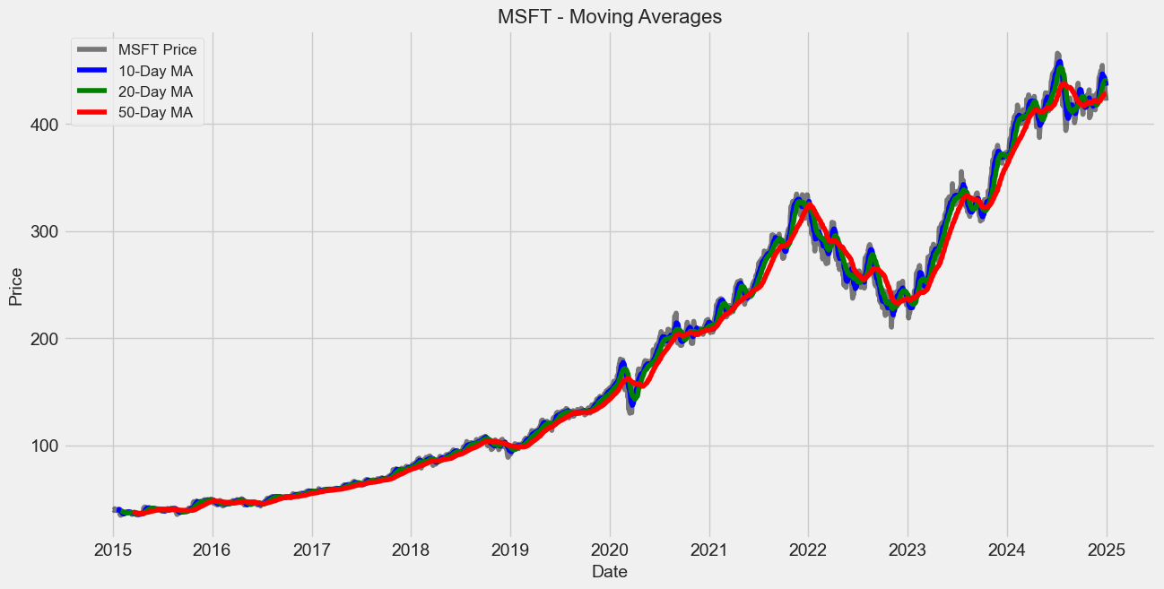
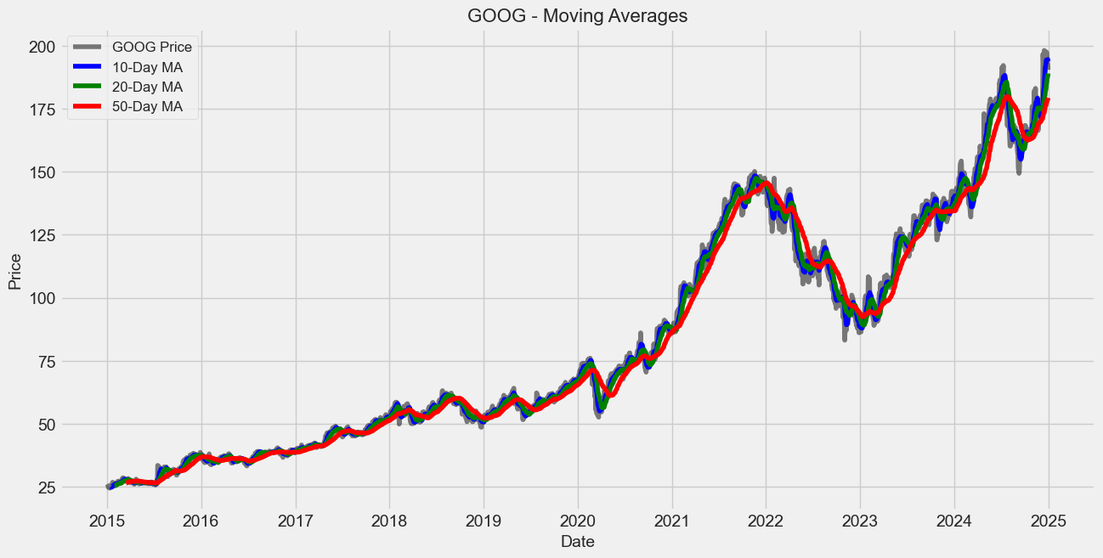
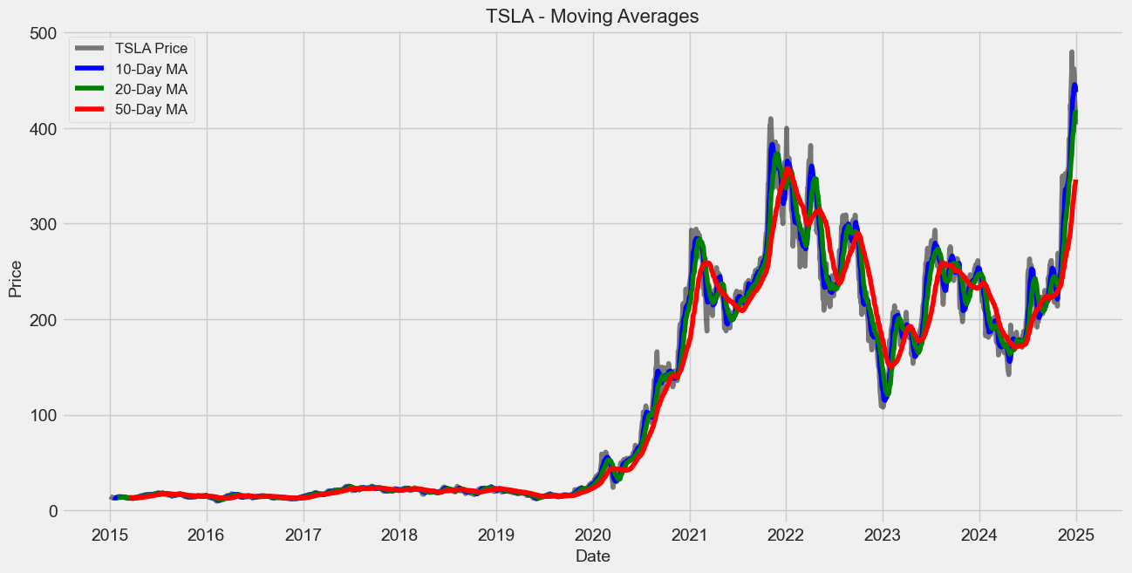
Moving Averages
The chart shows the price along with its 10-day, 20-day, and 50-day moving averages (MA)
The 20-day MA acts as a dynamic support/resistance level during trending periods.The 50-day MA is particularly useful for identifying long-term trends in price movements.
META's price appears to have experienced significant volatility, especially around 2022, likely due to market reactions to its rebranding and challenges in the digital advertising space.
MSFT's price shows lower volatility compared to stocks like TSLA or META, reflecting its stability as a blue-chip tech company.

Slide 12
Moving Averages
The charts reveal differences in volatility among the stocks:
TSLA shows the highest volatility, with sharp price swings and frequent crossovers of the moving averages.
AAPL and MSFT exhibit more stable trends, with smoother moving averages and fewer crossovers.
GOOG and META fall somewhere in between, with moderate volatility.
Volatile stocks like TSLA may offer higher returns but come with greater risk, while stable stocks like AAPL and MSFT are better suited for conservative investors.

Slide 13
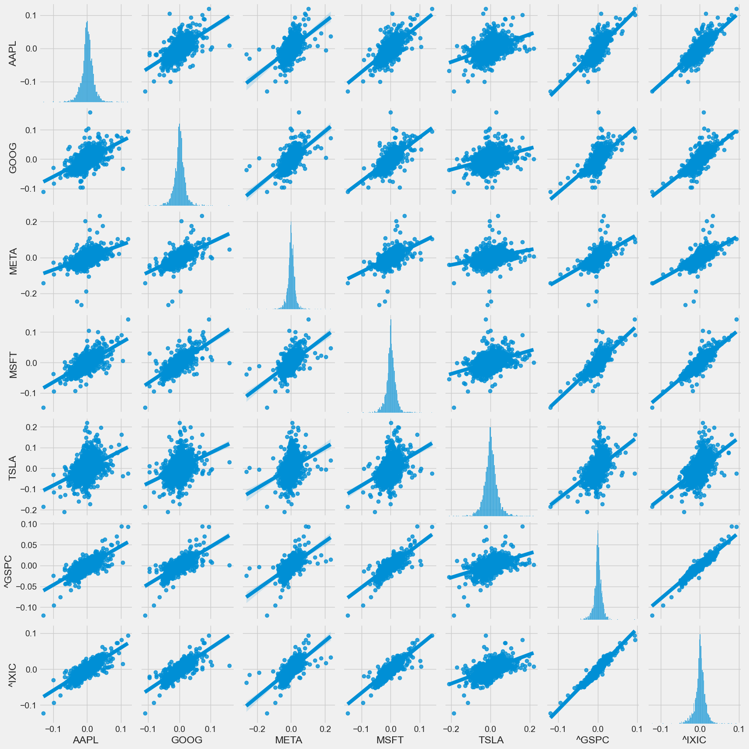
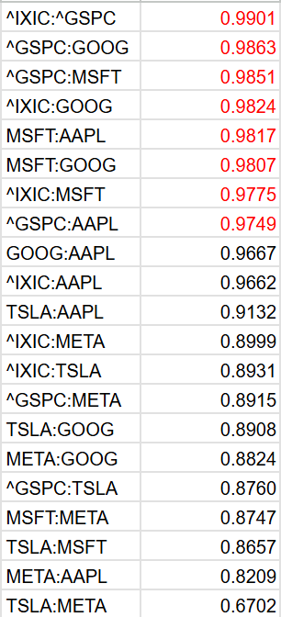
Closing price correlation
Data related to the performance or some metric (relationships on daily returns between all the stocks and closing percentage changes) of the 7 stocks/indexes: ['AAPL', 'GOOG', 'MSFT', 'TSLA', 'META', 'Nasdaq(^IXIC)', 'SP500(GSPC)'] over the period 2015-2024.
The relationships on daily returns between all the stocks.
Indicated the correlation between stocks daily returns and to investigate that individual comparison.

Slide 14
Closing price correlation
Here are 3 potential insights that can be derived from such data:
1. Volatility Analysis (Closing price per. change)
Values (e.g., ranging from -0.2 to 0.2) indicate the volatility of the stocks/indexes.
TSLA and META show wider ranges (e.g., -0.2 to 0.2), suggesting higher volatility.
AAPL and MSFT show relatively smaller ranges (e.g., -0.1 to 0.1), indicating lower volatility.
Investors might prefer less volatile stocks like AAPL or MSFT for stable returns, while risk-tolerant investors might favor TSLA or META for higher potential gains.

Slide 15
Closing price correlation
2. Correlation Between Stocks and Indexes
The data can be used to analyze the correlation between individual stocks (e.g., AAPL, GOOG) and the broader market indexes (e.g., ^IXIC for Nasdaq, ^GSPC for S&P 500).
The movements of AAPL, GOOG, etc., closely follow ^IXIC or ^GSPC, it suggests a strong correlation with the market.
If certain stocks (e.g., TSLA) deviate significantly, they might be less influenced by market trends.
Diversification strategies can be optimized by selecting stocks with low correlation to the market or each other.

Slide 16
Closing price correlation
3. Performance Trends Over Time
The data likely shows periodic performance trends (e.g., daily, monthly, or yearly returns).
Positive values (e.g., 0.1, 0.2) indicate periods of growth.
Negative values (e.g., -0.1, -0.2) indicate periods of decline.
By analyzing trends, investors can identify seasonality or long-term growth patterns for specific stocks or indexes.

Slide 17
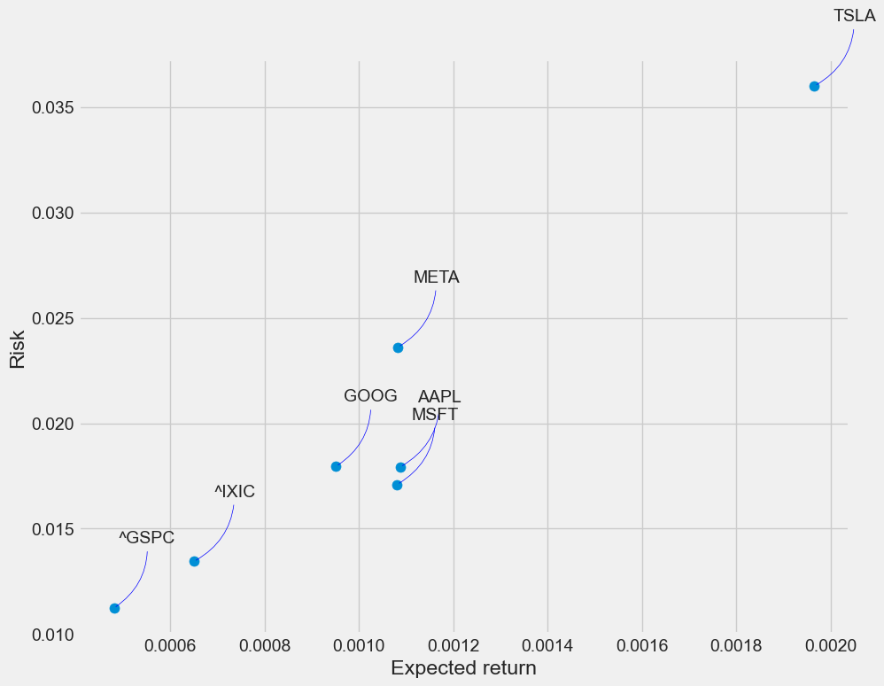
Risk and expected return
The information we've gathered on daily percentage returns is by comparing the expected return with the standard deviation of the daily returns.
The image appears to be a risk-return plot for the 7 stocks/indexes: ['AAPL', 'GOOG', 'MSFT', 'TSLA', 'META', '^IXIC', '^GSPC'] over the period 2015-2024.
The x-axis represents risk (likely measured as variance or standard deviation of returns), and the y-axis represents expected return.

Slide 18
Risk and expected return
Here are 3 key insights that can be derived from such a plot:
1. Risk-Return Tradeoff
The plot shows the classic risk-return tradeoff, where higher expected returns are associated with higher risk. For example:
TSLA has the highest expected return (~0.035) but also the highest risk.
S&P 500 has the lowest expected return (~0.010) and the lowest risk.
Investors must balance their risk tolerance with their return expectations. Aggressive investors might prefer TSLA, while conservative investors might favor S&P 500
2. Outperformance of TSLA and META
TSLA and META are positioned higher on the plot, indicating they offer higher expected returns compared to other stocks/indexes. However, they also carry higher risk.

Slide 19
Risk and expected return
3. Stability of AAPL and MSFT
AAPL and MSFT are positioned in the middle of the plot, offering moderate expected returns (~0.020–0.025) with relatively lower risk compared to TSLA and META.
These stocks provide a balance between risk and return, making them suitable for moderate-risk investors.
AAPL and MSFT are likely seen as stable, blue-chip investments with consistent performance.

Slide 20
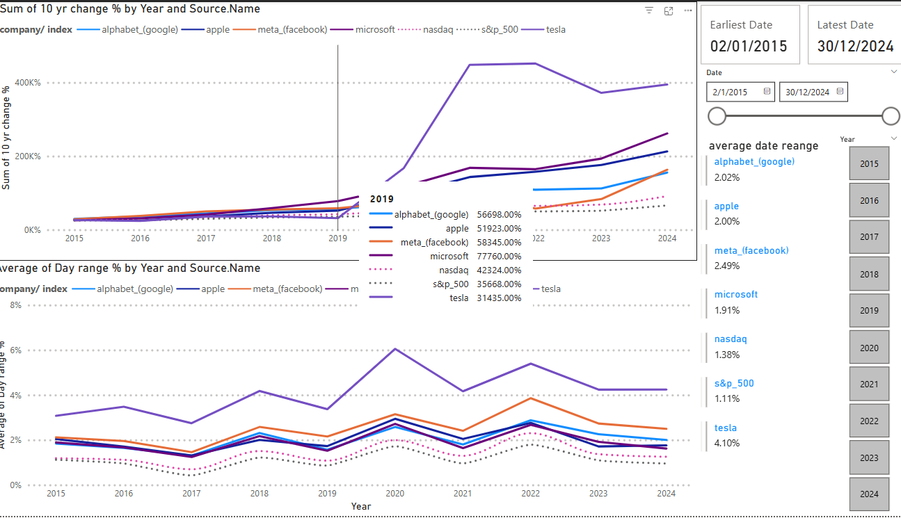
Data feature - Overall
Company Performance Trends (2015-2024)
Sum of 10-Year Change (%) by Year for Major Companies
Average Day Range by Year for Selected Companies
Alphabet (Google) shows significant growth, peaking in 2019.
Apple maintains a steady upward trend, reflecting consistent performance.
Meta (Facebook) exhibits volatility, with noticeable fluctuations in growth rate.
Tesla demonstrates remarkable growth, especially post-2019, indicating strong market demand.
Conclusion:
The data highlights varying performance trajectories among leading tech companies, with Alphabet and Tesla showing particularly impressive growth in recent years.
Notes:
Presentation Script: Company Performance Analysis
Slide 1: Introduction
"Good [morning/afternoon], everyone. Today, we will be analyzing the performance of major tech companies against market indices from 2015 to 2024."
Slide 2: Overview of the Data
"In this analysis, we will focus on five key companies: Alphabet (Google), Apple, Microsoft, NASDAQ, and Tesla. We will examine their year-on-year changes and average performance over the selected years."
Slide 3: Sum of Year-on-Year Change
"Let's start with the first graph, which illustrates the sum of year-on-year changes for each company."
"As we can see, from 2015 to 2024, there are noticeable fluctuations in performance. For instance, Tesla shows a significant increase, particularly in the later years, indicating strong growth."
"In contrast, while Alphabet and Apple also show positive trends, their growth rates appear more stable compared to Tesla's volatility."
Slide 4: Average Yearly Change
"Now, moving to the second graph, we focus on the average yearly change."
"Here, we see that Tesla leads with an average change of 4.10%, showcasing its strong market position."
"Apple and Microsoft follow with more modest changes, reflecting their established status in the tech industry."
"Interestingly, Alphabet's average change is lower than expected, suggesting potential areas for improvement."
Slide 5: Conclusions
"In conclusion, this analysis highlights the dynamic nature of the tech market. Tesla's aggressive growth strategy has set it apart, while the more established companies like Apple and Microsoft continue to maintain steady performance."
"These insights can guide future investment decisions and strategic planning for the companies involved."

Slide 21
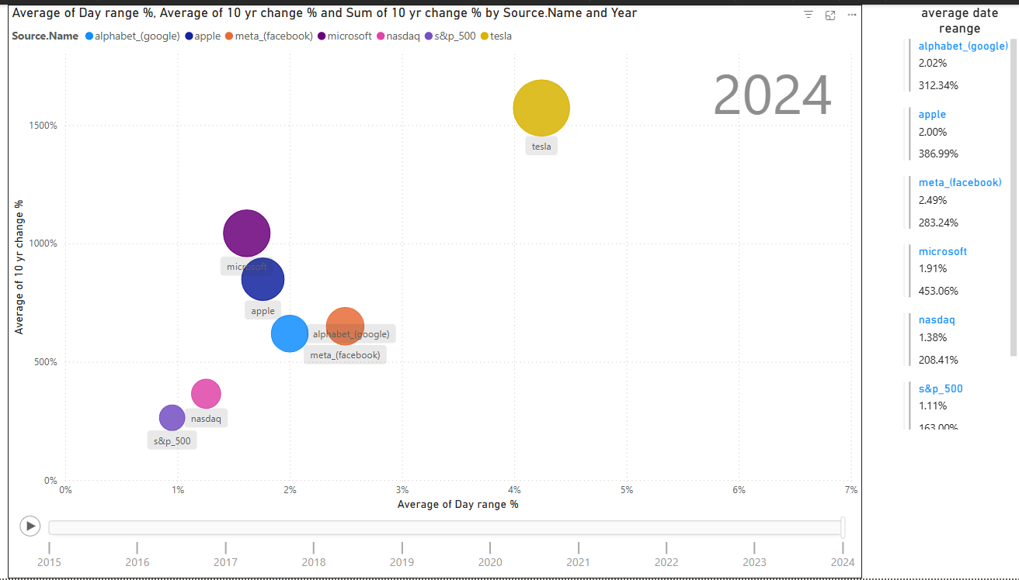
Average Daily % Change vs 10 Year % Change
Average Day Range Percentage
10-Year Change Percentage
These metrics will help us understand volatility and growth.
Tech companies show strong long-term growth compared to market indices.
Tech companies are more volatile than market indices
Tech companies:
High growth but have higher volatility.
Indices:
stability but with lower returns.
This highlights the trade-off between risk and reward

Slide 22
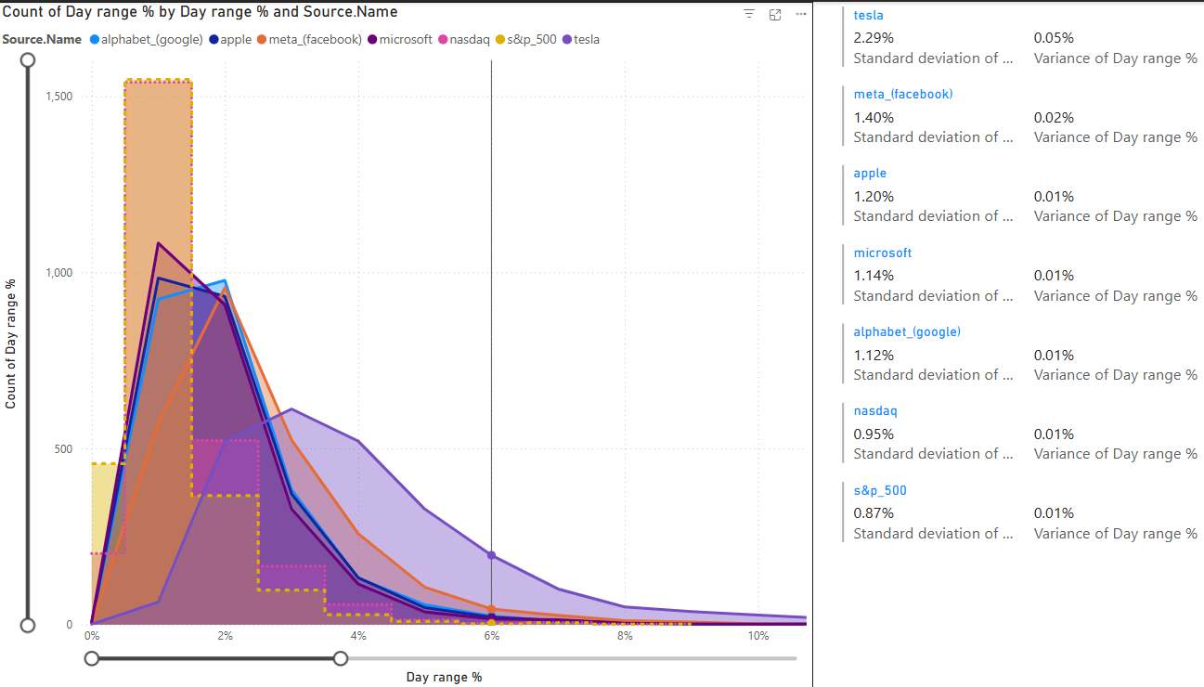
Count of Day Range %
Day range histogram To understand which companies or indices experience the most significant daily price fluctuations. - Standard Deviation + Variance:
To help us understand the consistency of daily price movements.
- Higher values indicate greater volatility.
Summary:
Tesla exhibits the highest daily volatility, while the S&P 500 is the most stable. Tech companies:
greater price fluctuations compared to market indices.
Investors should consider these volatility levels when making investment decisions.

Slide 23
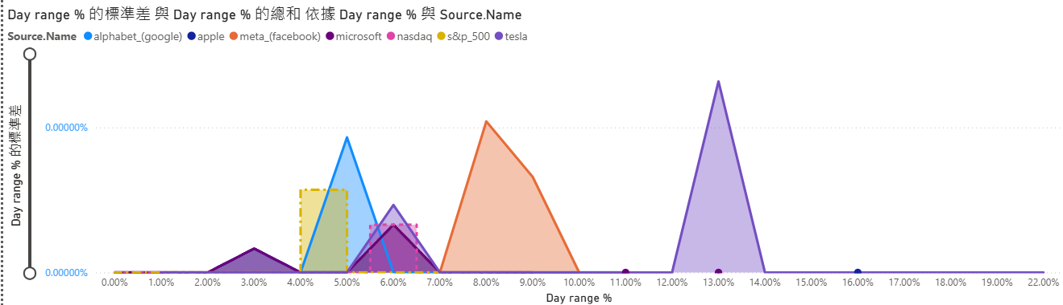
Day Range % vs SD of Day Range %

Slide 24
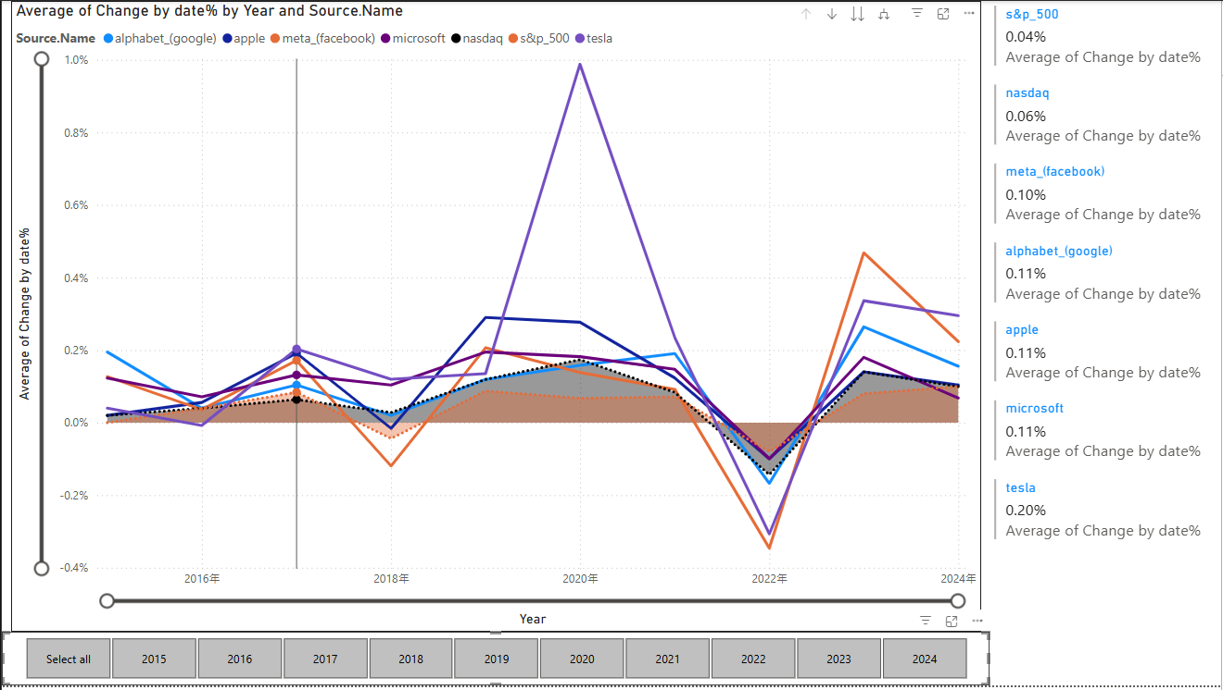
10 year Change by date%

Slide 25
Machine Learning

Slide 26
03
Methodology

Slide 27
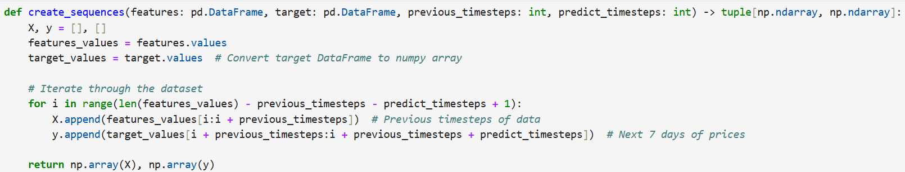
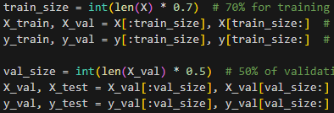
Rolling Window Split
Training Set Creation
help capture the temporal patterns in the dataset.
allows the model to learn from past observations to predict future values.
70% of the dataset would be used for training
15% would be used for testing
15% would be used for validation

Slide 28
Model Selection - LSTM
The Long Short-Term Memory (LSTM) model was frequently used and tested for stock price prediction given of its recurrent neural network (RNN) nature. Inspired by the work of Burak Gülmez (2023), we referenced his work and recreated the LSTM architectures for this project. The following table shows the LSTM architecture.
If the values of x1 and x3 is 0, these layers do not exist. The second and third layer is connected to variables
Output layer with 7 neurons.
Value of x0 to x6 will be generated by Artificial Rabbit Optimisation (ARO)
Layer | Parameter
Input layer | (90, 3)
LSTM | x0
LSTM(x1) | x2
LSTM(x3) | x4
Dense | x5
Dropout | x6
Dense | 7
Learning rate | x7

Slide 29
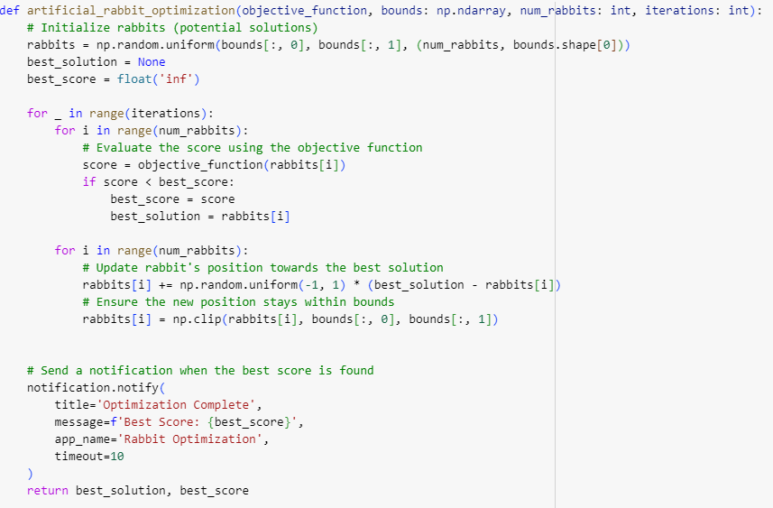
Artificial Rabbit Optimisation
ARO is a new metaheuristic algorithm inspired by the survival strategies of rabbits. It's designed to solve complex optimization problems by mimicking the behaviors of rabbits, such as their foraging and hiding strategies.
Defined Search Space
x0 | [1,20]
x1 | [0,20]
x2 | [1,20]
x3 | [0,20]
x4 | [1,20]
x5 | [7,30]
x6 | [0.3,0.7]
x7 | [0.000001, 0.01]
The most optimal parameter is determined by the best_score, which is the lowest MSE in the model

Slide 30
04
Analysis and Discussion

Slide 31
Analysis and Evaluation
The evaluation is structured around three key components:
Loss Curves: We will analyse the training and validation loss curves to assess the model's learning efficiency and potential overfitting issues.
Actual vs. Predicted Prices: A visual comparison of actual and predicted stock prices will help identify how well the model captures market trends.
Performance Metrics: We will examine various metrics, including RMSE (Root Mean Squared Error), MAPE (Mean Absolute Percentage Error), MAE (Mean Absolute Error), and R² (R-squared), to quantify model performance and accuracy.
Additionally, we will conduct a real-life comparison of actual and predicted percentage changes in stock prices to provide insights into the model's effectiveness. Through this comprehensive analysis, we aim to uncover the strengths and weaknesses of the LSTM model, leading to recommendations for future improvements.

Slide 32
Loss Curve
The loss value typically represents the Mean Squared Error (MSE), which measures the average of the squares of the differences between predicted and actual values. It quantifies how far off the predictions are from the true values, giving more weight to larger errors due to the squaring of differences.
From the below graphs, the plot of Training Loss and Validation Loss indicates:
Both losses decrease significantly and stabilize, suggesting effective learning.
The gap between training and validation loss is small, indicating minimal overfitting.
This low value suggests that the model performs exceptionally well, effectively capturing the underlying trends in the data. It indicates high accuracy in predictions, making it a reliable model for forecasting stock prices.

Slide 33
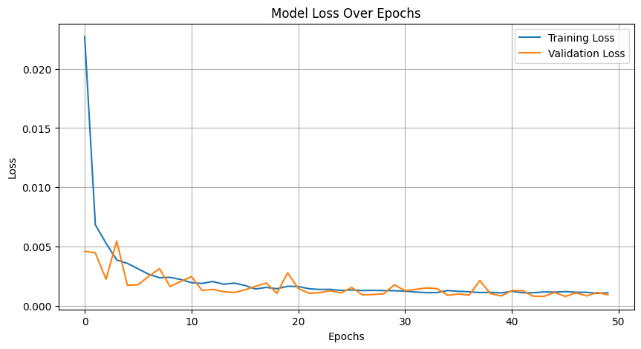
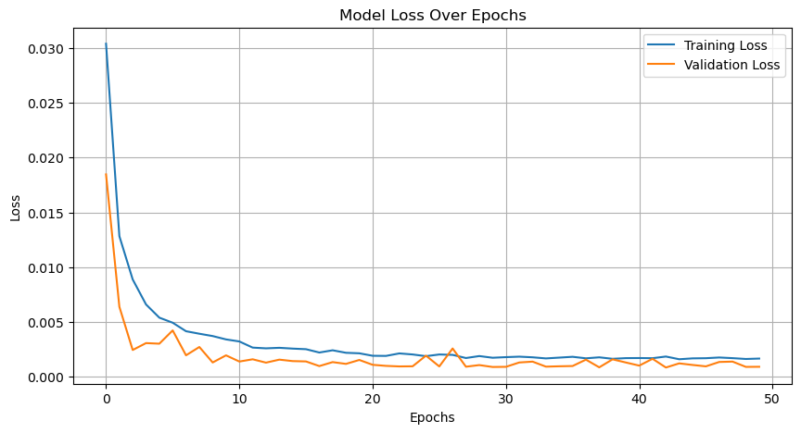
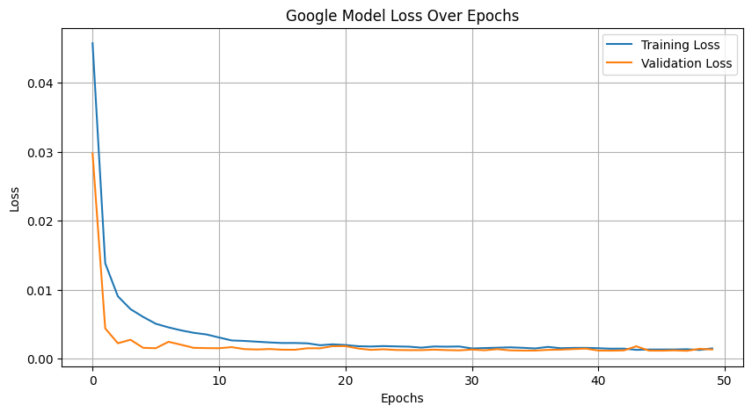
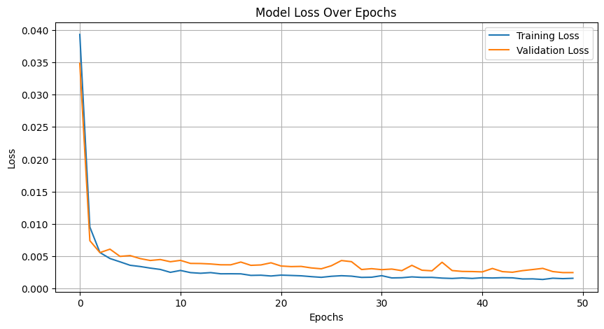
Apple Inc. (AAPL)
Microsoft Corporation (MSFT)
Alphabet Inc. (GOOGL)
Tesla, Inc. (TSLA)
Meta Platforms, Inc. (META)

Slide 34
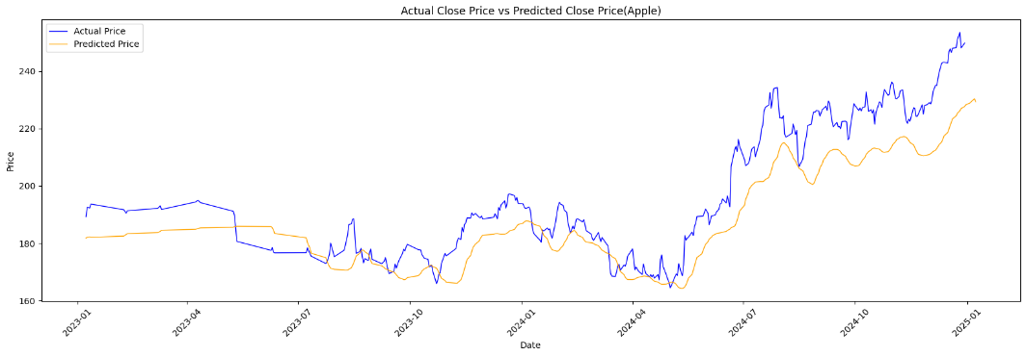
Actual vs Predicted Prices
Apple Inc. (AAPL)
The graph comparing Actual Close Price vs. Predicted Close Price shows:
The predicted prices follow the actual prices reasonably well.
But there are points of divergence, particularly during high volatility periods.

Slide 35
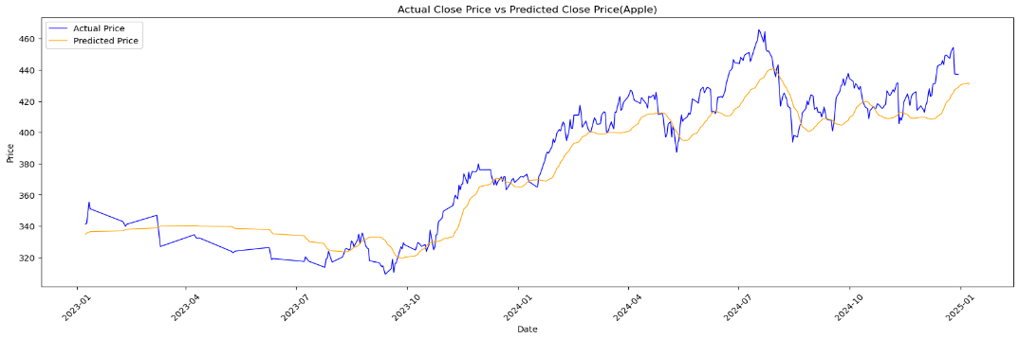
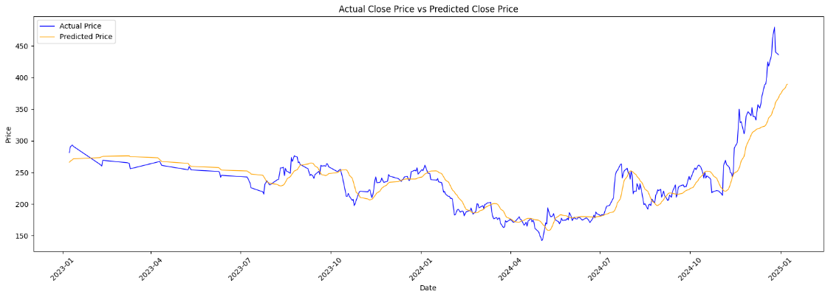
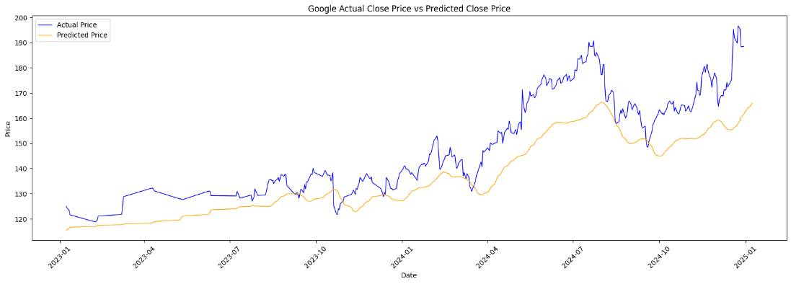
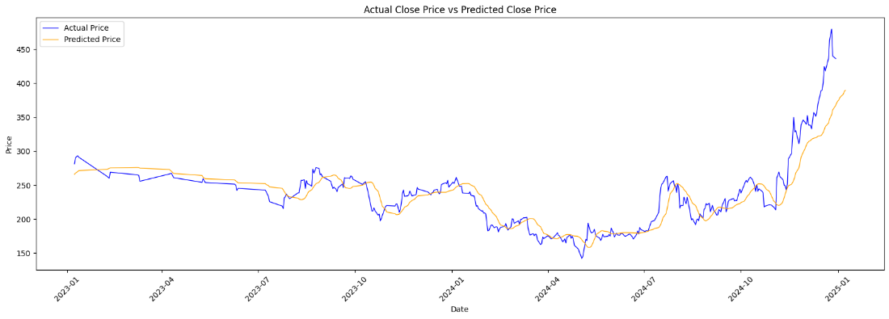
Microsoft Corporation (MSFT)
Alphabet Inc. (GOOGL)

Slide 36
Performance Metrics
(i)RMSE (Root Mean Squared Error)
The average prediction error for Microsoft is approximately $14.87, which is competitive compared to other companies, except for Apple, which has the lowest RMSE at $12.89. In contrast, both Tesla and Meta show higher errors at $25.91 each.
(ii)MAPE (Mean Absolute Percentage Error)
The MAPE values for all companies are notably high, indicating significant challenges in accurately capturing price movements. Microsoft and Tesla exhibit a MAPE of 99.80%, while Meta has a similar value of 99.79%. Apple and Google perform slightly better with MAPE values of 99.64% and 99.56%, respectively. This suggests that the model's predictions are, on average, nearly 100% off across the board.
Metric | Meta | Microsoft | Tesla | Apple | Google
Root Mean Squared Error (RMSE) | 25.91 | 14.87 | 25.91 | 12.89 | 14.02
Mean Absolute Error (MAE) | 17.87 | 12.11 | 17.87 | 10.50 | 11.95
R-squared (R²) | 0.79 | 0.87 | 0.79 | 0.71 | 0.46

Slide 37
Performance Metrics
(iii) MAE (Mean Absolute Error)
MAE measures the average magnitude of errors without considering their direction. For Microsoft, the MAE is $12.11, while Apple has the best performance with an MAE of $10.50. In contrast, Tesla and Meta show higher MAE values of $17.87 each, indicating that, on average, the model’s predictions are relatively accurate but still have a margin of error.
(iv) R² (R-squared)
The R² value indicates the proportion of variance in stock prices that can be explained by the model. Microsoft leads with an R² of 0.87, suggesting a strong correlation between predicted and actual values. Tesla and Meta have a solid R² of 0.79, while Apple’s value of 0.71 indicates a moderate correlation. Google, however, has the lowest R² at 0.46, suggesting that only 46% of the variance in stock prices can be explained by the model.
Metric | Meta | Microsoft | Tesla | Apple | Google
Root Mean Squared Error (RMSE) | 25.91 | 14.87 | 25.91 | 12.89 | 14.02
Mean Absolute Error (MAE) | 17.87 | 12.11 | 17.87 | 10.50 | 11.95
R-squared (R²) | 0.79 | 0.87 | 0.79 | 0.71 | 0.46

Slide 38
Performance Metrics
Metric | Meta | Microsoft | Tesla | Apple | Google
Root Mean Squared Error (RMSE) | 25.91 | 14.87 | 25.91 | 12.89 | 14.02
Mean Absolute Error (MAE) | 17.87 | 12.11 | 17.87 | 10.50 | 11.95
R-squared (R²) | 0.79 | 0.87 | 0.79 | 0.71 | 0.46
Conclusion
Best Performance: Apple had the lowest RMSE and MAE, suggesting the best predictive performance.
High MAPE: All companies showed high MAPE, indicating challenges with volatility.
R² Values: Microsoft had the highest R², indicating it explained the most variance; Google had the lowest.

Slide 39
Real-life Comparison
Analysing the percentage changes in stock prices for major companies like Meta, Microsoft, Tesla, Apple, and Google provides crucial insights into the effectiveness of our LSTM predictive model. By comparing the actual price changes with predicted values, we can identify discrepancies that highlight the model's strengths and weaknesses to further modify the model.
 | Meta | Microsoft | Tesla | Apple | Google
Actual % change | +4.31% | +0.73% | -2.20% | -3.08% | +2.46%
Predicted % change | +1.33% | +0.24% | +4.73% | +0.45% | +2.24%
Underestimation of Positive Changes: For Meta and Microsoft, the model tended to underestimate positive movements, which may indicate that it could benefit from incorporating more recent data or additional features that capture market sentiment.
Significant Discrepancies: For Tesla and Apple, the model's predictions deviated significantly from actual outcomes, highlighting potential issues in recognizing negative market influences or events that led to declines in their stock prices.
Relative Accuracy: Google’s prediction was relatively accurate, suggesting that the model can effectively capture trends for certain companies under specific conditions.
The results indicate that while the LSTM model can provide valuable insights, it also has limitations in predicting stock price changes accurately. Discrepancies between actual and predicted values highlight the need for further refinement of the model and consideration of additional data sources or features to enhance its predictive capability. Continuous analysis of both long-term patterns and short-term market dynamics will help improve future predictions.

Slide 40
05
Challenges and Limitations

Slide 41
(I) Discussion of Challenges Faced During the Project
Data Quality Issues: Ensuring the dataset was clean and comprehensive presented challenges, particularly in addressing missing values and outliers, which could skew analyses.
Complex Visualizations: Creating clear and informative visualizations required careful design to accurately represent trends and correlations without misleading interpretations.
Model Complexity: Tuning hyperparameters for the LSTM model was time-consuming, necessitating multiple iterations to achieve optimal performance. The complexity of deep learning models made it challenging to strike a balance between accuracy and training efficiency.
Computational Resources: Training deep learning models can be resource-intensive, resulting in longer training times, especially with larger datasets. This limited the ability to perform extensive hyperparameter tuning within the project timeline.

Slide 42
(II) Limitations of the Approach or Dataset
Historical Bias: The reliance on historical data may not accurately reflect future market conditions, limiting the generalizability of insights obtained from both the EDA and machine learning analyses. This bias could impact the model's predictive accuracy and relevance in changing market environments.
Feature Limitations: Both the EDA and machine learning analyses focused primarily on a limited set of features. In the EDA, this may oversimplify complex relationships in the data, while in the machine learning model, the emphasis on the "Close" price as the sole target variable restricted robustness. Incorporating additional features, such as trading volume and market sentiment, could enhance overall predictive capabilities and provide a more comprehensive analysis of market dynamics.

Slide 43
Potential Areas for Future Improvement
Feature Expansion: Future analyses could incorporate additional features, such as trading volumes, news sentiment, technical indicators, and macroeconomic data, to provide deeper insights into stock price movements and improve predictive power and robustness.
Advanced Analytical Techniques: Utilizing machine learning for unsupervised learning (e.g., clustering) could reveal hidden patterns in the dataset that traditional EDA might miss, enhancing the understanding of market dynamics. Moreover, exploring more complex architectures, such as Gated Recurrent Units (GRUs) or attention-based models, may yield better performance and capture intricate patterns in the data.
Ensemble Methods: Combining multiple models could enhance accuracy and reduce prediction variance, leading to more reliable forecasts.
Real-time Analysis: Implementing a framework for real-time data analysis could enhance the relevance and applicability of findings, allowing for timely decision-making.

Slide 44
06
Future Work

Slide 45
Future Work
(I) Description of Any Additional Ideas or Approaches Not Implemented
Sentiment Analysis: Integrating sentiment analysis from social media or news sources could provide valuable context for price movements, potentially improving prediction accuracy.
Real-time Prediction: Developing a system for real-time stock price prediction using live data streams could enhance the model's applicability in trading scenarios, offering real-time insights to investors.
(II)Reasons for Not Implementing These Ideas
Time Constraints: Due to limited time, the focus was primarily on building a functional LSTM model with historical data.
Complexity: Implementing additional features or models would require more extensive validation and testing, which was not feasible within the project timeline.

Slide 46
07
Conclusion

Slide 47
(I) Summary of the Project's Objectives and Achievements
Both the EDA and machine learning components aimed to enhance understanding of the financial performance of major tech companies while leveraging machine learning techniques for stock price prediction. The EDA provided foundational insights into trends, correlations, and volatility, while the LSTM model demonstrated the potential for effective predictions based on historical data.
(II) Key Takeaways and Insights Gained
The importance of data preprocessing and feature selection in building effective predictive models cannot be overstated.
The LSTM architecture capability to learn from historical sequences highlights its suitability for time-series forecasting.
The project underscored the potential for further enhancements through feature engineering and advanced modeling techniques, paving the way for future research and applications in financial analysis.
By addressing the challenges, limitations, and potential future directions identified in both the EDA and machine learning components, this project can evolve into a more robust analytical framework, ultimately supporting better investment decision-making and financial literacy.

Slide 48
Thanks!
Do you have any questions?

